Slide 1
Event Logging
Analytics for Wikimedians
User:Strainu

Slide 2
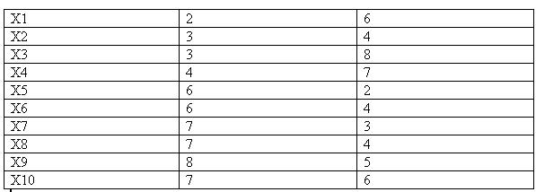
What does it do?
Notes:
Tables!

Slide 3
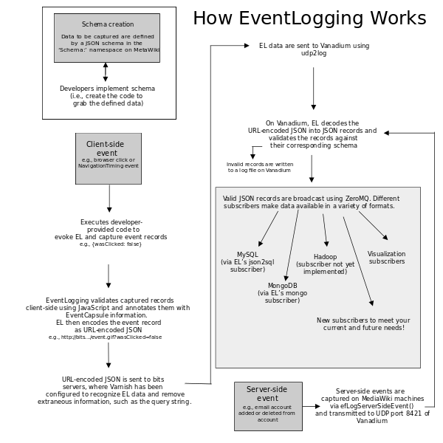
But, how?
Follow the grey boxes:
create the schema
log the event
consume the data
Notes:
Actually, EL hides most of this graph, so you don’t have to worry about it!
You only need to create the schema, register and consume the data.
No worries on where the data is kept, how it gets there or where the data is recorded from.
Outdated details: kafka instead of ZeroMQ, Hadoop seems to be implemented.

Slide 4
Let’s dig into it!

Slide 5
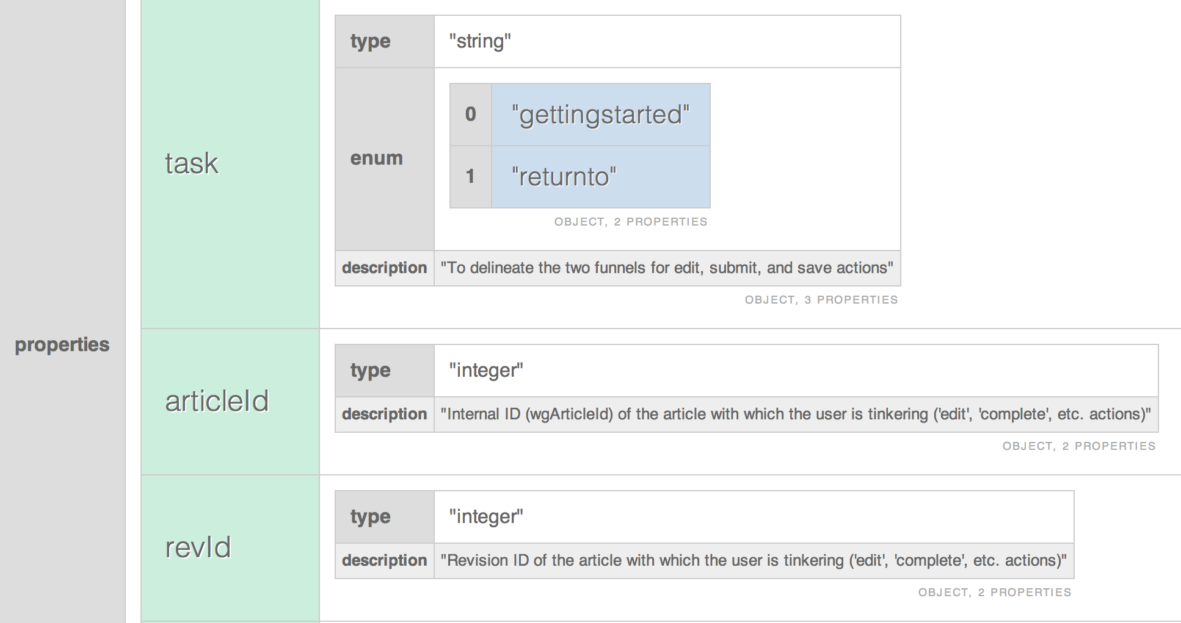
Create the schema
Create a json schema file on meta, in the Schema: namespace
Only pages on meta are accepted; no Vagrant page, no Wikipedia
The revision id is important! Each revision has a different table in the MySQL backend
Example is part of [[m:Schema:GettingStarted]]

Slide 6
Log the data
You can log data from wherever you can access the beacon
Theoretically, there are APIs for JS and PHP
In reality, I had to write my own function
More data is added silently, see [[m:Schema:EventCapsule]]
All the “identifiable” data is there: wiki, user-agent etc.
Once you know what you want to log, a new event can be added in under an hour
var logEvent = function(schema, revision, event) { var payload = { schema: schema, revision: revision, wiki: 'metawiki', event: event }; var url = 'https://meta.wikimedia.org/beacon/event' + '?' + encodeURIComponent(JSON.stringify(payload)); document.createElement( 'img' ).src = url; };
logEvent( 'DiacriticsVisibility', 15606222, {"issues": issues, "country": window.Geo.country} );

Slide 7
Profit!
Well, at least if you write your own consumer.
If not, you will probably have a database table which only Analytics people can access due to privacy concerns.
To get the data, you need to sign an NDA or use [[wikitech:Analytics/Reportupdater]]

Slide 8
Why haven’t I heard of EL sooner?
Perhaps you have: EL is not a secret.
Blame the NDA: Some people might be discouraged by the lack of access to the results without support from an employee
Easy input, hard output: it’s relatively easy to configure a probe based on available examples with minimal programming knowledge, but you’re on your own when interpreting the results
Notes:
Many of the experiments made by the WMF teams are based on EL and they do mention it in their presentations
Solution: anonymize the results automatically either on recording or when the user requests the results
Solution: we could use more subscribers that require less programming knowledge (some output to OpenRefine, LibreOffice Calc, Excel perhaps?)

Slide 9
Data privacy for EL
We need to follow the WMF Privacy Policy, but others don’t
The more data we collect, the easier it is to reconstruct user behavior if someone subpoenas (or steals) that data
Checks were put in place to limit access to the data
There is also a retaining policy - most raw data is deleted after 3 months

Slide 10
Thank you!

Slide 11
Bonus slides

Slide 13
Documentation
https://www.mediawiki.org/wiki/Extension:EventLogging#Documentation (incomplete and confusing)
#wikimedia-analytics (friendly and knowledgeable :)
https://ro.wikipedia.org/wiki/MediaWiki:DiacriticsPoll.js (my implementation; the magic is in the logEvent function)

Slide 14
Image attribution
https://commons.wikimedia.org/wiki/File:Kmedoidt1.jpg by User:Shrikantnangare, PD
https://commons.wikimedia.org/wiki/File:EventLogging2.svg by User:Kmenger, CC-BY-SA-3.0
https://commons.wikimedia.org/wiki/File:EventLogging_Schema.png by DarTar, CC-BY-SA-3.0
https://commons.wikimedia.org/wiki/File:RomanianTrafficSign_C01-NoEntry_2011.svg by Alex:D, CC-BY-SA-3.0
Youtube movie is available on commons: https://commons.wikimedia.org/wiki/File:EventLogging_Workshop.webmhd.webm by Chip Deubner, CC-BY-SA-3.0

